Slide 1
July 18th, 2017 Proposed Small Business Taxation
October 16, 2017 Small Business Rate to change from 10.5% to 9.0%
Dave Faulkner, CLU, CFP CEO Razor Logic Systems Inc. RazorPlan.com
Notes:
Introduction. Before I talk about the July 18th tax proposals, you may be wondering why the restaurant in the background looks familiar.
Well this is where Finance Minister Bill Morneau and Prime Minister Justin Trudeau made the announcement on October 16th over lunch to change the small business tax rate from 10.5% to 9% over the next two years.

Slide 2
October 2, 2017
During the 75 day consultation period, over 21,000 written submissions were received by the Department of Finance!
Assuming each submission required 30 minutes to read and catalog the content, it would take 131 people working full time 8 hour per day for 2 weeks to get through all 21,000.
Notes:
Why the change?

Slide 3
July 18, 2017 Tax Proposals
Four main changes dealing with:
Income sprinkling.
Lifetime Capital Gains Exemption (LCGE).
Conversion of a corporation’s regular income into capital gains.
Taxation of passive investment income.
Notes:
What are the small business tax proposals that Finance introduced on July 18th?

Slide 4
July 18th Tax Proposals 1. Income Sprinkling
Personal Earnings
Corporate Dividends
$200,000 Income
$70,000
Tax
$30,000 + $40,000
Tax
$130,000
After-Tax
$130,000
After-Tax
Finance, “This is Good”
Notes:
Why does Finance want to change the income sprinkling rules?

Slide 5
July 18th Tax Proposals 1. Income Sprinkling
Personal Earnings
Corporate Dividends
$200,000 Income
$70,000
$25,000
$25,000
$130,000
$75,000
$75,000
$20,000 Tax Saved
Finance, “This is Bad”
Notes:
What if this person’s spouse is a shareholder of the business?

Slide 6
July 18th Tax Proposals 1. Income Sprinkling
Personal Earnings
Corporate Dividends
$200,000 Income
$7,500
$7,500
$70,000
$42,500
$42,500
$42,500
$42,500
$130,000
$7,500
$7,500
$40,000 Tax Saved
Finance, “This is Very Bad”
Notes:
What if this person has children over 18, maybe in university who are also shareholders?

Slide 7
July 18, 2017 Curtailment of Income Sprinkling?
Effective in 2018, changes will expand on the “Kiddie Tax” rules – section 120.4 of the ITA.
Proposed measures include:
Expanding on “specified individual” to include certain adults between 18 and 24 years old.
Introducing a new “reasonableness test” for income received by a specified individual.
Adding a new “connected individual” to tax dividends that are subject to the new reasonableness test.
Expanding the definition on what is considered “split income”.
Notes:
How did Finance intend to make things fair?

Slide 8
After October 16th 1. Income Sprinkling
Submissions focused on:
Unintended consequences of the proposals.
Complexity associated with being compliant with the new rules.
The need for more clarity on the “reasonableness” of income received.
New measures will…
Simplify the rules.
Provide more clarity around family members involved in a family business.
Draft legislation to be provided before the end of 2017.
Notes:
What is the situation now?
Unintended consequences of the proposals.
Complexity associated with being compliant with the new rules.
The need for more clarity on the “reasonableness” of income received.

Slide 9
July 18th Tax Proposals 2. Lifetime Capital Gains Exemption (LCGE)
Business: $2,500,000 FMV
After LCGE
$625,000
Capital Gains
Tax
$835,716 LCGE
$416,071
Capital Gains
Tax
$1,875,000
After-Tax
$2,083,929
Estate Value
$208,929 Tax Saved
Finance, “This is Good”
Notes:
Why does Finance want to change the Lifetime Capital Gains Exemption (LCGE)?

Slide 10
July 18th Tax Proposals 2. Lifetime Capital Gains Exemption (LCGE)
Business: $2,500,000 FMV
After LCGE x 2
$625,000
Capital Gains
Tax
$835,716 LCGE
$207,142
Capital Gains
Tax
$1,875,000
After-Tax
$2,292,858
Estate Value
$417,858 Tax Saved
Finance, “This is Bad”
Notes:
What if this person’s spouse is a shareholder of the business?

Slide 11
July 18th Tax Proposals 2. Lifetime Capital Gains Exemption (LCGE)
Business: $2,500,000 FMV
After LGCE x 3
$625,000
Capital Gains
Tax
$835,716 LCGE
$0
Capital Gains
Tax
$1,875,000
After-Tax
$2,500,000
Estate Value
$625,000 Tax Saved
Finance, “This is Very Bad”
Notes:
What if this person has a family trust that owns shares in the business?

Slide 12
July 18th Tax Proposals 2. Lifetime Capital Gains Exemption (LCGE)
The 2017 LCGE is $835,716 for qualified small business shares.
Section 110.6 of the ITA governs eligibility.
Proposed measures include:
No LCGE for anyone under age 17 by the end of the previous tax year.
No LCGE for disposition of property that is included in split income.
No LCGE on gains accrued while property was held by a family trust.
Changes apply to dispositions after 2017, with some grandfathering rules for 2018 dispositions except where there are trust beneficiaries.
Very complex set of rules.
Notes:
How did Finance intend to make things fair?

Slide 13
After October 16th 2. Lifetime Capital Gains Exemption (LCGE)
Submissions focused on:
The impact on intergenerational transfers of family owned businesses.
The impact on family owned farm corporations.
New measures will…
Will NOT proceed with the changes announced.
Notes:
What is the situation now?

Slide 14
July 18th Tax Proposals 3. Conversion of Income to Capital Gains
Redemption Planning
164(6) of the ITA
Estate
Beneficiaries
Last Will & Testament
Fail to complete transaction within 12 months of death, pay both taxes, $670,000!
In order to get the assets into the hands of the beneficiaries, the Corporation must distribute either cash or the assets from the corporation to the estate (or heirs) in the form of dividends.
Tax on
Dividends
$420,000
T1
Terminal
Return
Corporation
$1,000,000
Tax on Capital Gain $250,000
Finance, “This is Good”
Notes:
Why does Finance want to change the rules on conversion of income to capital gains?
To understand the issues facing this issue, we first need look at what happens when a business owner dies.
At death, Corporation is deemed disposed of at FMV and is now owned by the estate. In this example, $1,000,000 FMV would trigger $250,000 in capital gains tax.
In order to get the assets into the hands of the beneficiaries, the Corporation must distribute either cash or the assets from the Corporation to the Estate (or heirs) in the form of dividends. This creates a loss on the terminal return replacing $250,000 of capital gains tax with $420,000 tax on dividends.
Should this not be done within 12 months of the date of death, both taxes would be payable for a total of $670,000, or 67% of the FMV of the Corporation.

Slide 15
July 18th Tax Proposals 3. Conversion of Income to Capital Gains
Pipeline Planning
84(2) of the ITA
Estate
Beneficiaries
Last Will & Testament
The Result:
$250,000 of tax payable, vs.
$420,000 of tax payable.
After the estate transfers the shares to New Corp, the Corporation is wound up. New Corp can now flow the proceeds up to the estate (or heirs) by repaying the promissory note.
New Corp
$1,000,000
Estate Sells
Corporation
T1
Terminal
Return
Corporation
$1,000,000
Tax on Capital Gain $250,000
Finance, “This is Bad”
Notes:
To convert the dividend income to capitals gains, the estate incorporates a new corporation (“New Corp”) that will acquire the shares of the Corporation held by the estate.
A non-interest bearing promissory note equal to the fair market value of the shares is issued by New Corp.
The Corporation is then wound-up into New Corp and the assets are transferred to New Corp.
New Corp uses the assets to repay the promissory note to the estate.
New Corp is dissolved and resulting tax is $250,000.

Slide 16
July 18th Tax Proposals 3. Conversion of Income to Capital Gains
This type of planning is limited under existing anti-avoidance rules now.
Adjusted Cost Basis (ACB) Modification Clause, 84.1(2)(a.1) of ITA.
Proposed measures include:
Capital gains realized on “non-arms length” transactions will be treated as dividends.
Should sale of business be to family member, then taxable at the highest tax rate if considered “split income”.
Notes:
How did Finance intend to make things fair?

Slide 17
After October 16th 3. Conversion of Income to Capital Gains
Submissions focused on:
Many concerns on the tax impact of existing estates.
The unfairness when selling to a family member.
New measures will…
Will NOT proceed with the changes announced.
Notes:
What is the situation now?

Slide 18
July 18th Tax Proposals 4. Passive Investment Income
Personal Ownership
Corporate Ownership
$300
Refundable
Corp. Tax
$1,000 of Income
$20,000 Investment
Earning 5%
$300
Personal Tax
$1,000 of Income
$500
Personal Tax
$200
Corp. Tax
$500
After-Tax
Income
$500
After-Tax
Income
Finance, “This is Bad”
Notes:
Why does Finance want to change the taxation of passive investment income in a corporation?

Slide 19
July 18th Tax Proposals 4. Passive Investment Income
Personal $10,000 After-Tax
Corporate $17,000 After-Tax
$250
Refundable
Corp. Tax
$250
Personal Tax
$170
Corp. Tax
$250
Personal Tax
$500 of Income
$20,000 of Pre-Tax
Earnings
$850 of Income
$250
After-Tax
Income
$430
After-Tax
Income
Finance, “This is Very Bad”
Notes:
Its all about the pre-tax income that gets invested.

Slide 20
July 18th Tax Proposals 4. Passive Investment Income
What are the changes:
Eliminate RDTOH, the current 30.67% refundable tax will no longer be refundable.
Exclude public corporation dividends from General Rate Income Pool (GRIP).
Eliminate CDA from capital gains arising from sale of capital assets.
Apply a refundable tax to dividends transferred from one corporation to another.
Two alternative methods to manage the changes:
Apportionment Method - Track three source pools of income.
Elective Method - Income subject to non-refundable tax approximating top personal rate.
Notes:
How did Finance intend to make things fair?

Slide 21
July 18th Tax Proposals 4. Passive Investment Income
Personal $10,000 After-Tax
Corporate $17,000 After-Tax
$250
Personal Tax
$430
Corporate Tax
$20,000 of Pre-Tax
Earnings
$850 of Income
$170
Personal
Tax
$250
After-Tax
Income
$250
After-Tax
Income
+70% Combined
Corporate/Personal
Tax Rate!
Finance, “This is Good”
Notes:
So a 70% PLUS tax rate on passive income is fair?

Slide 22
After October 16th Curbing of Passive Investment Income
Submissions focused on:
The complexity income pools.
The outrage of +70% tax rate on investment income earned inside a corporation.
The potential impact on existing retirement plans.
New measures will…
Provide $50,000 of annual investment income ($1,000,000 earning 5%).
Confirmed previous announcements that any change would not affect current planning.
Draft legislation will be provided as part of the 2018 Federal Budget.
Notes:
What is the situation now?

Slide 23
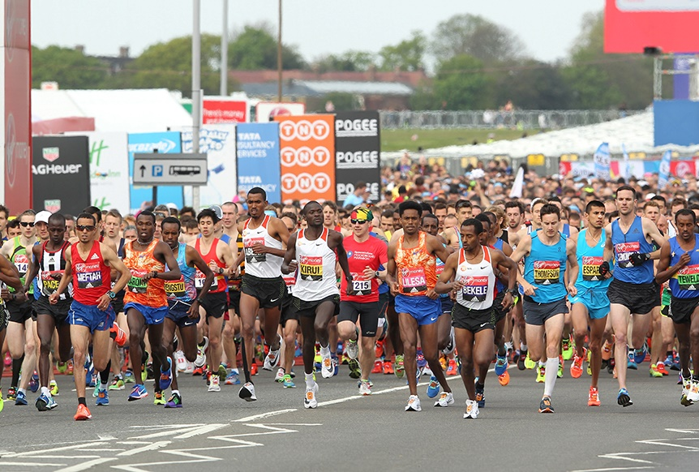
What The Finance Is Going On?
When planning for retirement, most people run a marathon, small business owners run a sprint!
Notes:
Why was there so much push-back from financial advisors and small business owners? For one thing, Finance never offered any analysis, and to my knowledge never did any. If they had, they would realize that there are 2 ways to plan for retirement.
The first is a marathon, the second is a sprint
Small business owners invest years into their businesses, sacrificing incomes and savings to create something that will pay-off in the future.
Instead of investing small amounts for years, they count on they last 10 years or so to save for retirement. Small business owners train all their working lives to run a “retirement” sprint and just when they are on the starting line, Finance says “we have changed the race to a marathon’.

Slide 24
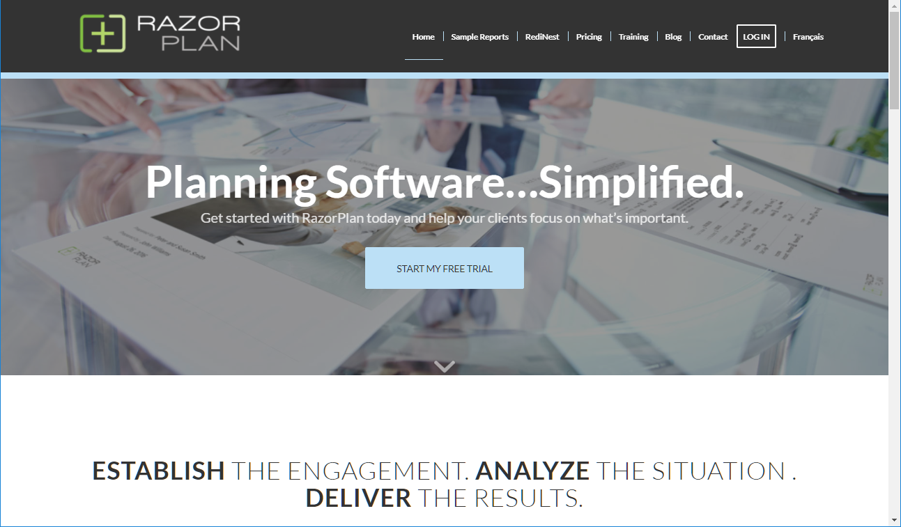
Notes:
So I decided to implement the July 18th proposed changes to passive investment income in a special version of RazorPlan software so that I could do what Finance failed to do, assess the impact these changes will have on the retirement plans of average Canadian business owners.

Slide 25
Finance Did Not Provide Retirement Income Analysis
Assumption | Employee Marathon | Small Business Sprint
Years to Retirement: | 10 (age 65) | 10 (age 65)
Life Expectancy Age: | 90 (25 years) | 90 (25 years)
RRSP Balance: | $470,000 | $0
RRSP Contributions ($100,000 salary): | $18,000 | $0
Passive Corporate Investment Balance: | $0 | $0
Passive Corporate Investment Savings: | $0 | $75,000
CPP Eligibility (Client/Spouse): | 100% / 25% | 75% / 25%
OAS Eligibility (Client/Spouse): | 100% / 100% | 100% / 100%
Real Return Investment Assumption: | 3.00% | 3.00%
All calculations assume Alberta 2017 tax rates.
Notes:
The assumptions are simple, (taxes assume 2017 Alberta tax rates).

Slide 26
Retirement Income Analysis
100%
99%
All calculations assume Alberta 2017 tax rates.
Notes:
When we compare their available after-tax income in today’s dollars, we see they are almost identical under the current corporate tax system, both receiving approximately $70,000. And although the employee would appear to pay more tax each year than the small business owner, this is because RRSPs provide a full deferral of tax where corporate savings offers a partial deferral.

Slide 27
July 18th Tax Proposals New Assumptions
Proposed Legislation:
No refundable tax on passive income.
No income splitting of dividends.
$1,000 Passive Income
$500
Corporate Tax
$200
Personal
Tax
$300
After-Tax
Income
All calculations assume Alberta 2017 tax rates.
Notes:
When you implement the July 18 proposed tax changes, including eliminating the refundable tax and not splitting dividend income between spouses. Using the previous example, this results in a potential 70% tax rate on investment income.

Slide 28
Retirement Income Analysis
100%
88%
99%
All calculations assume Alberta 2017 tax rates.
Notes:
If implemented, these proposals would provide only 88% of the after-tax income the employee will have.

Slide 29
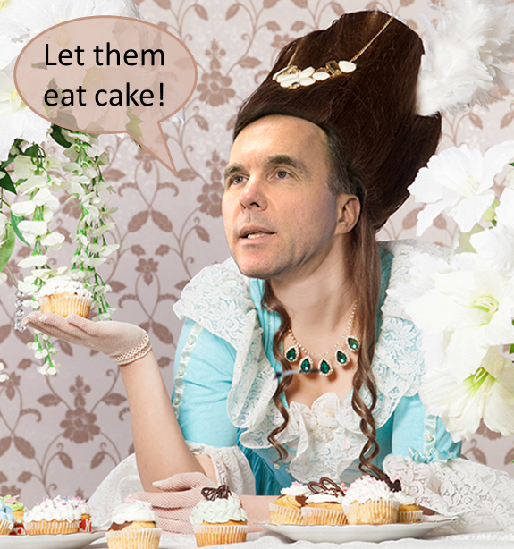
July 18th Tax Proposals Un-Realistic Assumptions
Use Personal Tax Shelters:
Bonus $86,000 annually.
Unused RRSP contribution room $316,000.
Annual contribution room $26,000.
RRSP contribution $55,000 for 10 years.
TFSA $52,000 for client & spouse, total $104,000.
TFSA contribution $20,200 for 10 years.
Notes:
One suggestion Finance offered to small business owners is to use RRSP and TFSA to save for retirement. This is Finance’s “Let them eat cake” response to the 70% tax on passive investment income. The $75,000 planned for corporate investment is withdrawn as “earned income”. To allow for maximum tax-sheltering, you have to assume $316,000 of unused RRSP contribution room and $104,000 TFSA room between the client and spouse.

Slide 30
Retirement Income Analysis
100%
104%
88%
99%
All calculations assume Alberta 2017 tax rates.
Notes:
So Finance is NOT wrong. In this example the same or better results can be achieved using existing personal tax shelters. But Finance is also NOT right! - NEXT

Slide 31
July 18th Tax Proposals Realistic Assumptions
Use Personal Tax Shelters:
Bonus $86,000 annually.
Maximum RRSP contribution room $26,000.
RRSP contribution $26,000 for 10 years.
TFSA $52,000 for client & spouse, total $104,000.
TFSA contribution $38,500 for 3+ years, then $11,000.
Non-registered investments once TFSA is maxed out.
Notes:
When you consider that small business owners avoid taking income over what is needed to survive so they can invest in their business, they likely do not have much if any RRSP contribution room. When you assume only $26,000 RRSP for 10 years and once TFSA are maximized, any available after-tax income is invested in non-registered, we get a very different result.

Slide 32
Retirement Income Analysis
100%
92%
104%
88%
99%
All calculations assume Alberta 2017 tax rates.
Notes:
Using realistic RRSP assumptions, our small business owner can expect only 92% of the after-tax retirement income of the employee. How is this fair?

Slide 33
After October 16th What Do We Know?
For now, we do not need to worry about changes to the Lifetime Capital Gains Exemption (LCGE) or the conversion of dividends to capital gains.
There will be changes to income splitting (TOSI) rules, details are promised by end of 2017.
There will be changes to passive investment income, draft legislation will be provided as part of Budget 2018.
Individual Pension Plans (IPPs) may become more relevant in tax planning given the proposed $50,000 limit on passive investment income.
Life insurance remains a powerful planning tool for small business owners, both as a tax shelter and estate planning tool.
Living benefits, structured using a shared ownership arrangement, still offers tremendous value in retirement planning.
Notes:
What do we know?

Slide 34
After October 16th Retirement Income Analysis
$190,000
Lost Income!
100%
95%
99%
All calculations assume Alberta 2017 tax rates.
Notes:
Has Finance retreated far enough? I don’t think so. In our example, even with the increased saving from the reduction in taxes to 9%, the small business owner will only enjoy 95% of the after-tax income of the employee. Assuming 3% inflation, future lost income is greater than $190,000 by life expectancy.

Slide 35
What Should You Do?
You need to understand how the proposed changes and any future changes to the Income Tax Act (ITA) could impact your financial security (retirement and estate plans).
A Financial Plan, before and after any tax changes go into effect, is necessary to develop your personal strategy to minimize the impact that any new taxes may have on your future.
Plan to meet with your financial advisor before the 2018 budget.
Notes:
What should you do?

Slide 36
Dave Faulkner, CLU, CFP,
CEO and co-founder of Razor Logic Systems Inc., an innovative software company whose flagship product, RazorPlan, provides financial planning software, tools, calculators and concepts to financial services firms, investment advisors and insurance professionals.
To download a copy of this PowerPoint that you can use with your clients, go to my blog at davefaulkner.ca or to the RazorPlan blog at razorplan.com/blog.
Notes:
As a financial advisor, you have permission to use this PowerPoint with your clients. You can change the design and content, add your branding and update the examples to match your province.

